Slide 1

Image Based Obstacle Detection and Free Space Mapping
Digital Image Processing (CP-406)
Presented by: Iqra Khadam (22-CP-35)
Attia Batool (22-CP-79)

Slide 2
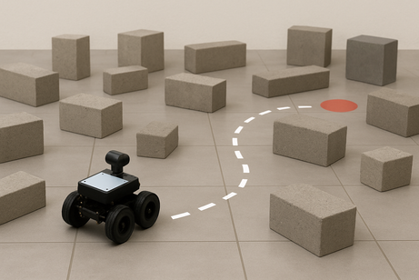
Problem Statement
• Autonomous navigation in unknown environments is challenging.
• Robots must detect obstacles and free space without prior maps
• Sensor-based systems are costly and complex.
• Goal: Develop a low-cost image based obstacle detection and path planning system.

Slide 3
Literature Review
• Majeed et al. (2019): Used edge detection and morphology for obstacle detection.
• Singh et al. (2020): Image-based navigation using grayscale and segmentation.
• Limitation: Many systems depend on datasets or specific environments.
• Research Gap: Need for fast, dataset-independent solution.

Slide 4
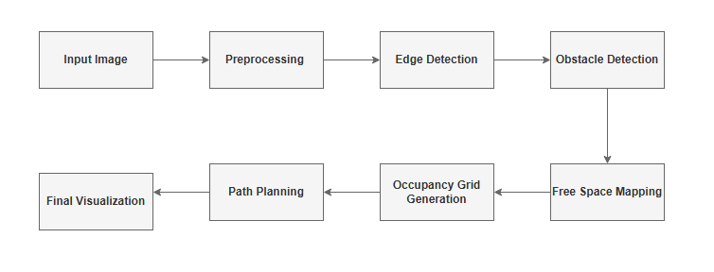
Proposed Solution

Slide 5
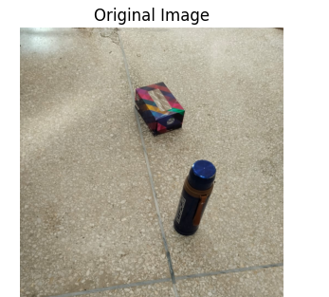
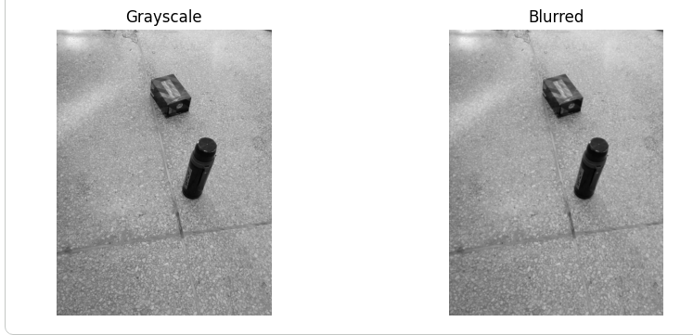
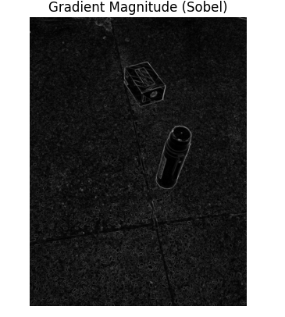
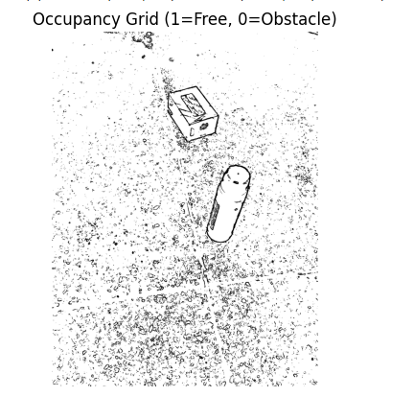
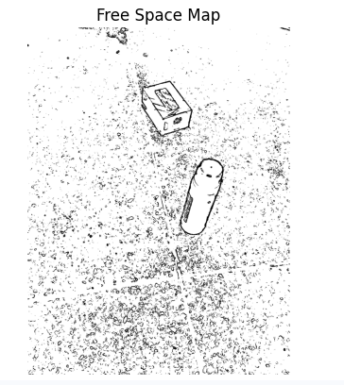
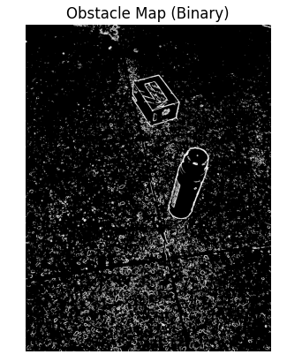
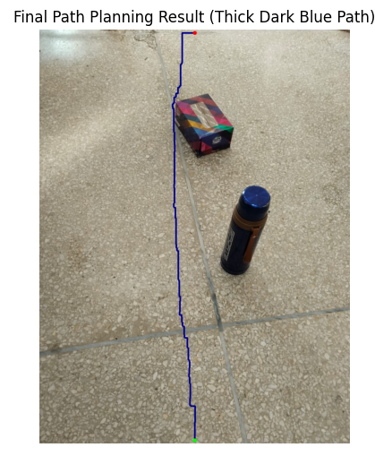
.

Slide 6

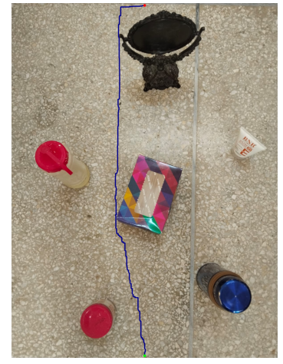
Results and Evaluation

Slide 7
Conclusion
• Image-based navigation achieved without datasets.
• Efficient and low-complexity system.
• Suitable for unknown environments.
• Future work: A*, dynamic obstacles, video input.

Slide 8
THANK YOU

